Slide 1
Django’s Fantasy
Developed by: Daniel Lukish, Dylan Giesler, Megan Achurra,
Miguel Perez Ojito, and Thomas Rudolph

Slide 2

Project Overview
Django Fantasy is a fantasy soccer league for newcomers. We provide simplified statistics about teams in the Premier League to help you make better decisions.
Pick 3 winning teams and 1 loser in a league draft
Gain and lose points based on team performance

Slide 3
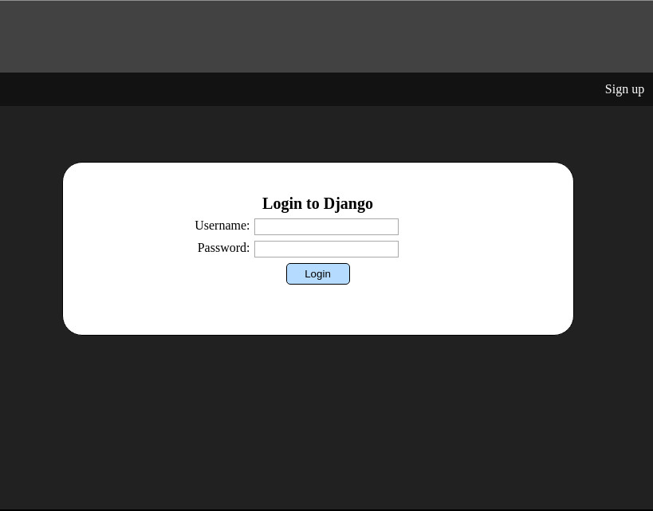
Name: Thomas Rudolph
Project Job: Backend programmer
Built: login.php, signup.php, and much of the backend functionality
This incrementation:
Built the delete user feature (done)
Currently working on the draft system
Will also build forgot password by the end of this incrementation

Slide 4
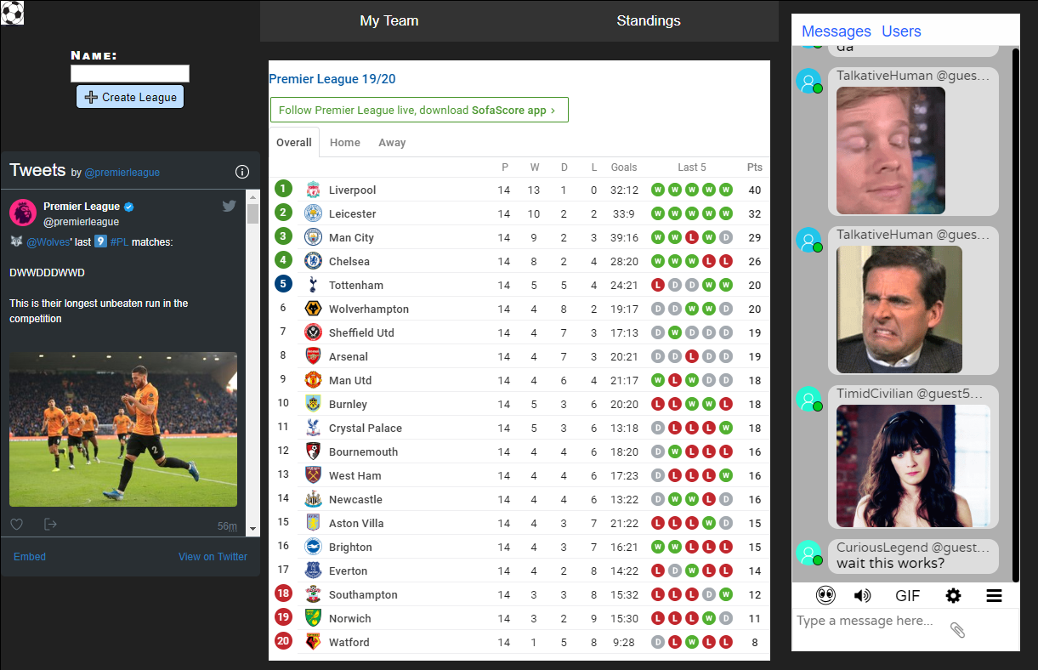
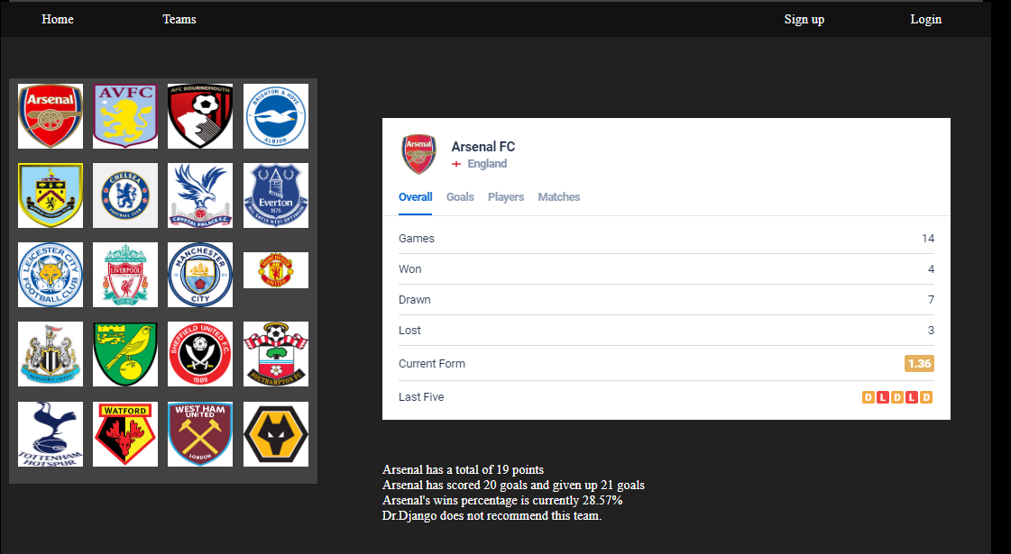
Name: Dylan Giesler
Project Job: Frontend programmer
Built: home.html and teaminfo.html
This incrementation:
Built teaminfo.html
Will be adding tooltips
Fixed a small error in home.html

Slide 5
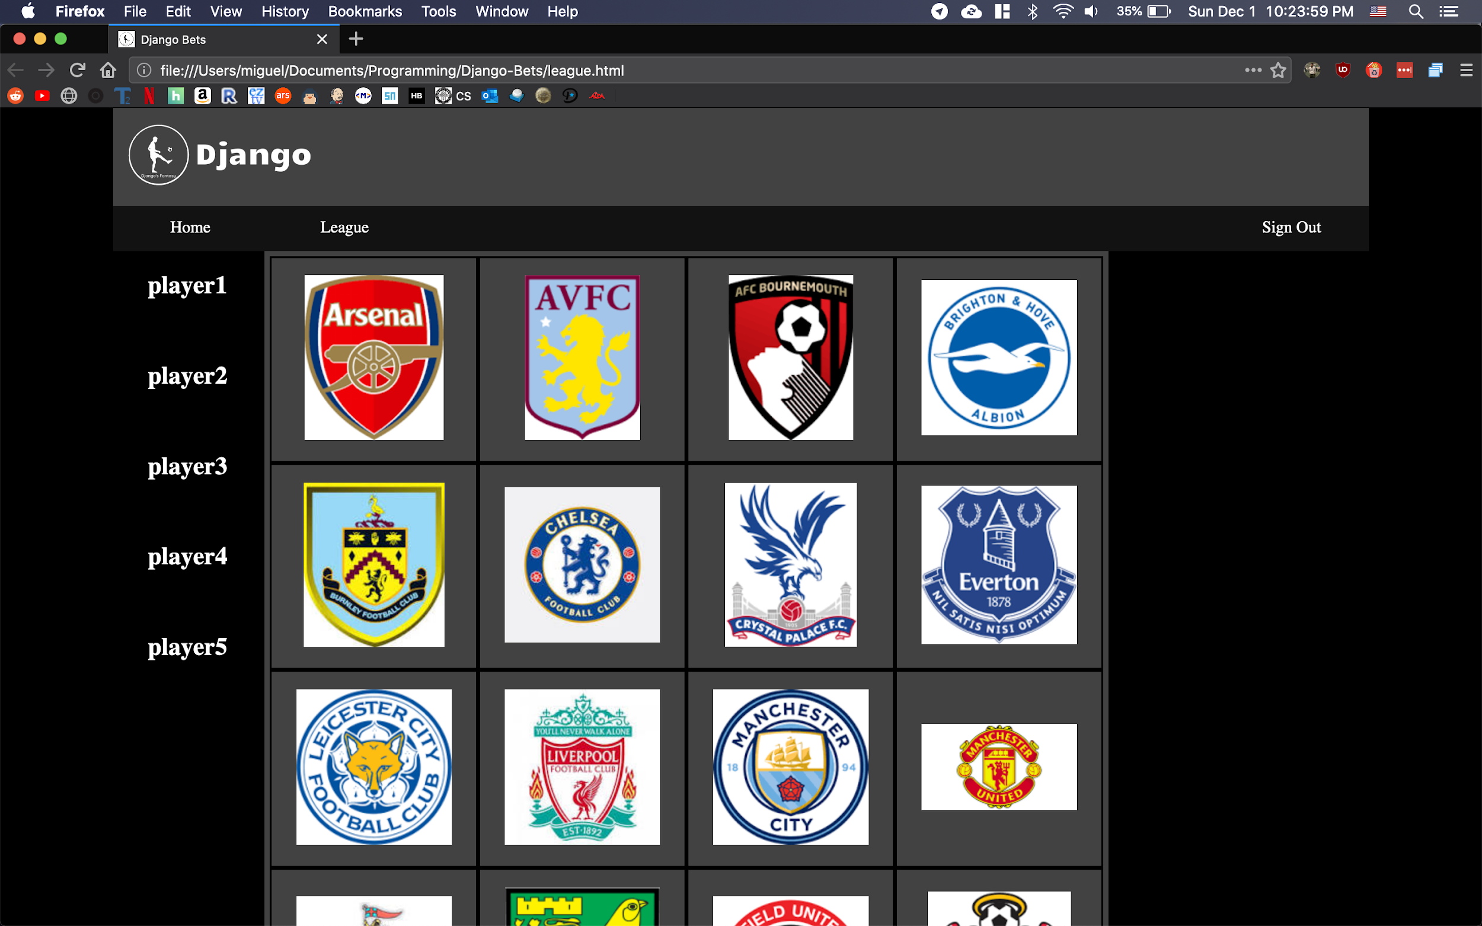
Name: Miguel A. Perez Ojito
Project Job: Frontend programmer
Built: league.html and league.css
This incrementation:
Made sure that the page would work on the most common browsers
And most common resolutions/aspect ratios

Slide 6
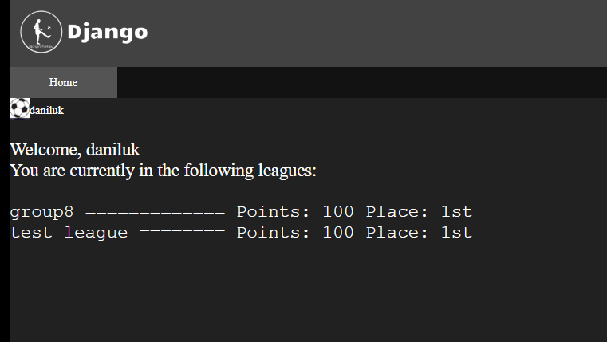
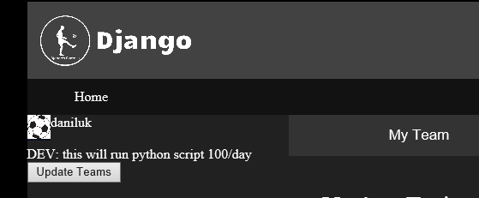
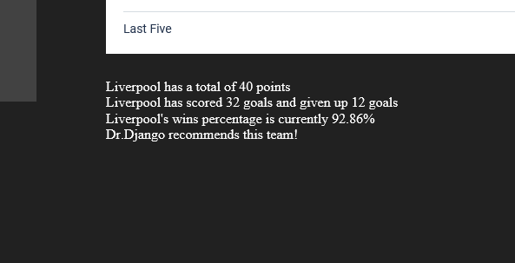
Name: Daniel Lukish
Project Job: Backend/API
Built: API script, profile.php
Added to: home.php, teaminfo.php, apitest.py
This incrementation:
Created automatic update of team tables through a button.
Added to the team info page with custom data and Dr.Django recommendations.
Python virtualenv and point system
Profile page started

Slide 7
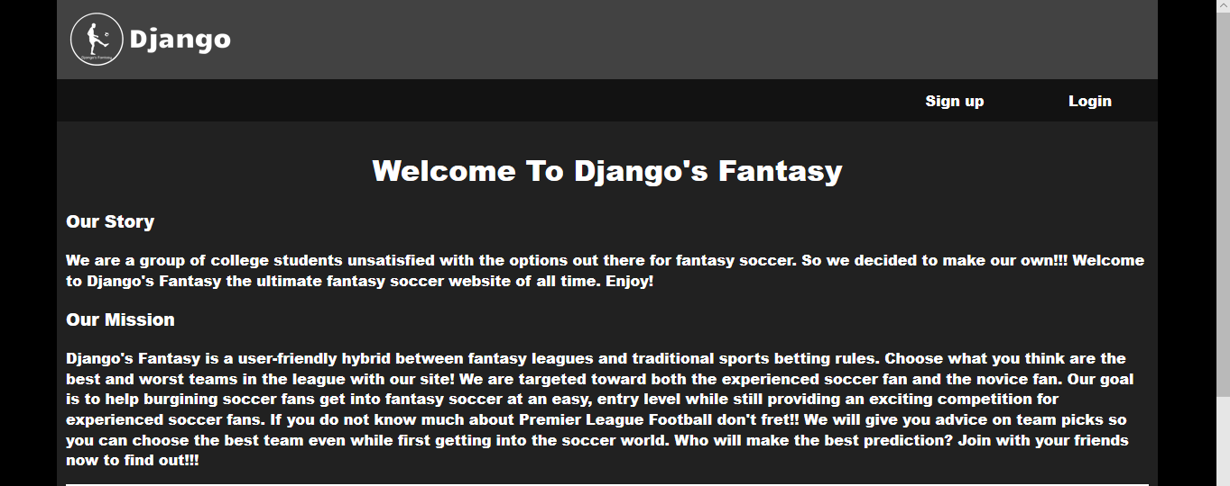
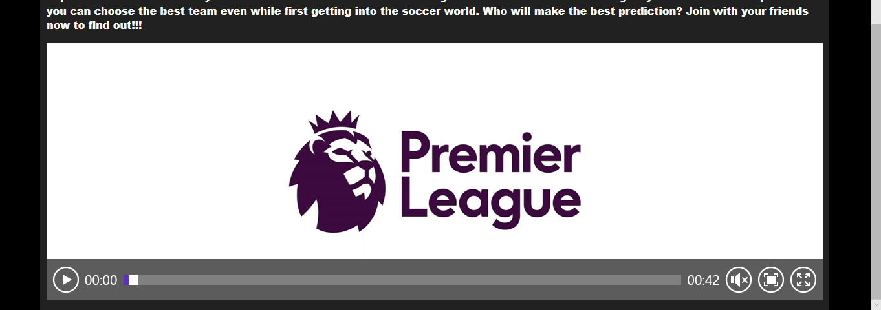
Name: Megan Achurra
Project Job: Frontend Programmer
Built: index.html and index.css
This incrementation:
Added an audio element to index
Will be testing index on most common browsers
Will be adding to video

